Slide 1
Status 27.06.2022 — afternoon
Work Group “Information Travel and Pandemics”

Slide 2
What we did
Physics tutoring for the non-physicists
Cooperatively working-out the core themes of the paper
Working out first implementations

Slide 3
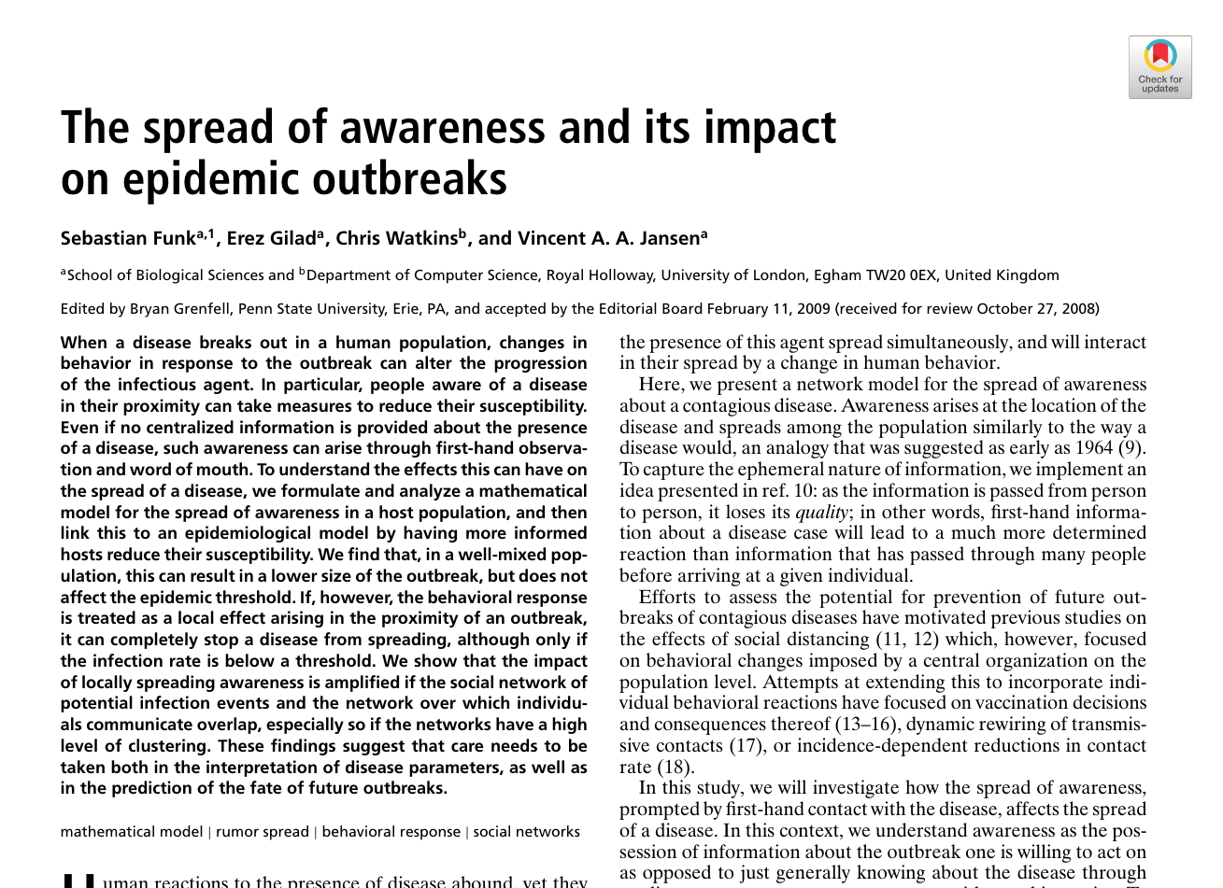
Paper of choice
FUNK, Sebastian, Erez GILAD, Chris WATKINS und Vincent A. A. JANSEN, 2009. The spread of awareness and its impact on epidemic outbreaks. Proceedings of the National Academy of Sciences of the United States of America. 21 April 2009. Bd. 106, Nr. 16, S. 6872–6877. DOI 10.1073/pnas.0810762106

Slide 4
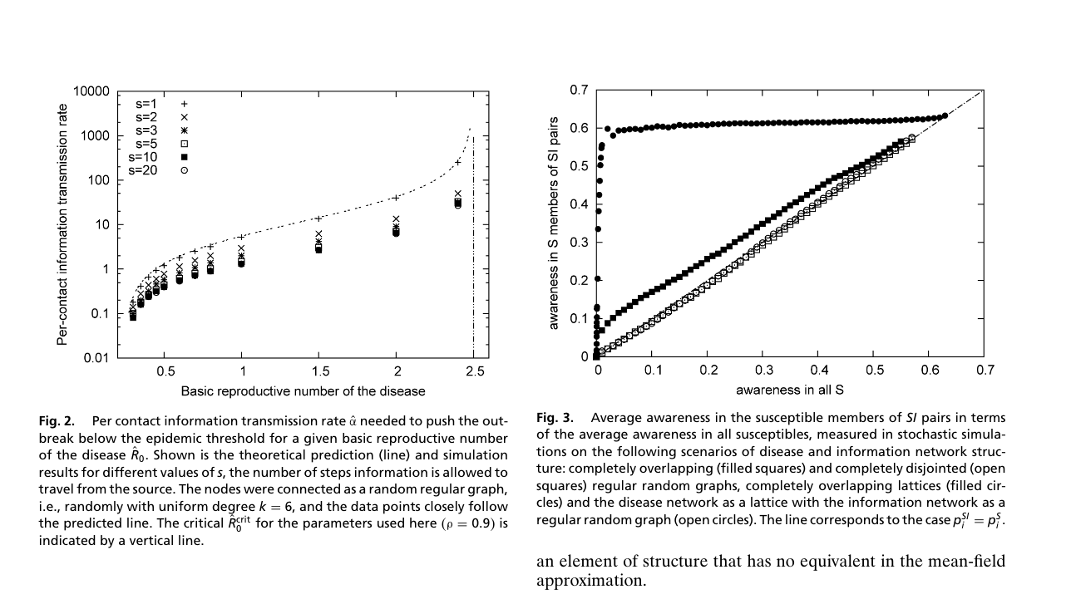
Paper II

Slide 5
Overview
Two aspects of epidemic spread: information and illness
Research: Influence of awareness on epidemic spreading.

Slide 6
Model
Disease
SIR-Model
Awareness (leads to precaution -> lowers susceptibility)
Illness raises awareness
Awareness is transmitted, dampened by transmission
Awareness is dampened over time

Slide 7
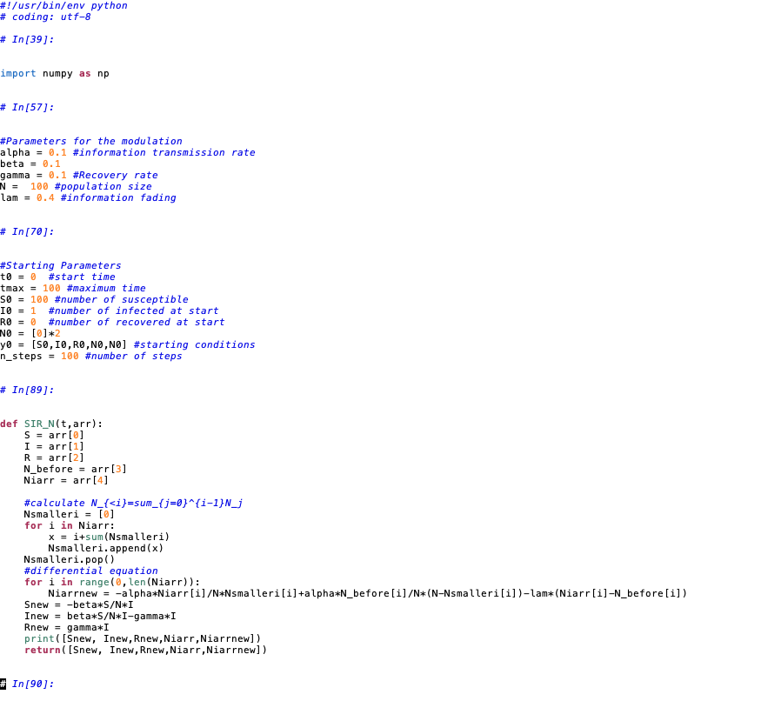
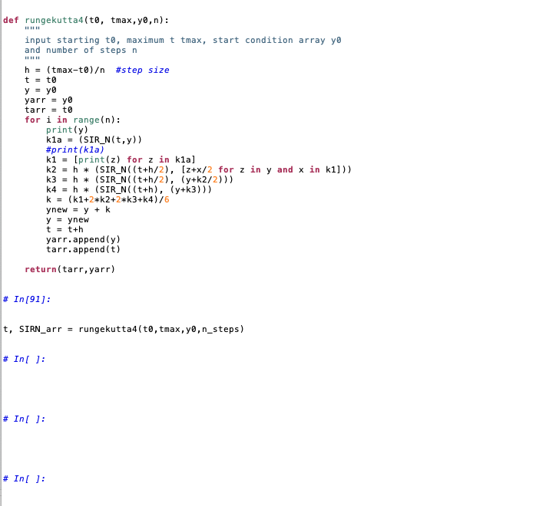
Codebeispiel

Slide 8
Working group goals
Focus on the mean-field analysis and modify the model from there

